Slide 1
Gender as Embedded in Societal Structure, Social Context, & the Self: Opportunities and Obstacles
Amanda B. Diekman
Department of Psychological & Brain Sciences
Indiana University

Slide 2
Diekman & Schmader, forthcoming
Handbook of Social Cognition
Notes:
Thanks to my collaborator and a bit background about us
Toni Schmader
Professor and Canada Research Chair
University of British Columbia
Toni and I are both social psychologists – social psychology as a discipline can span from neuroscience to social structure but the core question is about the relationship between the individual and society
My own positioning is as a social structuralist – that we can understand what gender means and how it matters by understanding the positioning of men and women in the social structure
But let me start by asking you to consider a few paradoxes where gender is concerned

Slide 3
Key points
Gender has real impact even if it not biologically essential
Gender categories act as organizing forces, lead to expectations, and structure experiences
Gender cognitions are the fuel that form these categories & their consequences

Slide 4
Categorization is powerful
Simplify continuous behavior into categories
Carothers & Reis, 2013
Binary amplifies difference
Most psychological gender differences small to moderate in size (Hyde, 2005)
Binary gender categorization can overshadow
intersections with other identities
Images from Every Breath We Take,
Jess Dugan
Notes:
We must understand the ways in which we are beholden to the binary in order to move beyond the binary
I invite YOU to ask these questions – what I have here is a starting framework to understand how the limitations of a binary, categorical understand of gender. Science as an institution (like media) is not outside of these cultural processes. Elaborating the embddedness of the categories is not an ending point; it is a starting point.
So what you identify as limitations – falling back on the binary, assuming majority white data is universal – those are starting places. Not to acquit us of our responsibility but acknowledging this is where science is right now and how might we go further? STARTS with your questions

Slide 5
institutions
interactions
individual
How are societal institutions organized around gender? What roles do women and men occupy?
How do dyadic or group interactions create gender?
How is gender encoded in the self?

Slide 6
How are binary categories embedded?
Organization
Expectations
Experience

Slide 7
institutions
interactions
individual
How are societal institutions organized around gender? What roles do women and men occupy?
How do dyadic or group interactions create gender?
How is gender encoded in the self?

Slide 8
interactions
individual
institutions
Other-related cognitions
stereotypes, attitudes
Implicit & explicit knowledge about what is expected and appropriate for others
Role-related cognitions
roles, norms
Implicit & explicit knowledge about what is expected and appropriate about this position
Self-related cognitions
self-concept,
gender identity
Implicit & explicit knowledge about what is expected and appropriate for the self
Notes:
Cognitions are the fuel that translate between levels
Start with individual: what are the key cognitive constructs

Slide 9
Content of gender cognitions
Expectations and experiences associate
Women & female gender role with communality
Men & male gender role with agency
interactions
institutions
individual
Notes:
Cognitions are the fuel that translate between levels
Start with individual: what are the key cognitive constructs

Slide 10
I. Institutions
Role-related cognitions
roles, norms
Implicit & explicit knowledge about what is expected and appropriate about this position
institutions
Societal institutions shape cognitions
Social role theory; role models
Gendered cognitions shape institutions
Self-selection; justification

Slide 11
Social Role Theory
Descriptive stereotypes
Prescriptive stereotypes
(gender norms)
gender-role
expectations
division of labor
between gender groups
gender differences in
social behavior
gendered skills
and beliefs
--Eagly & Wood, 1991, 2012
Eagly, Wood, & Diekman, 2000
Notes:
social role theory : locates source of sex differences and gender stereotypes in the distribution of men and women into social roles
circular function: leads to sex differences in training and skill, which then circle back to maintain sex segregation
METHODOLOGY
--questionnaire asked to imagine target
--rate target on characteristics
--estimate percentages of occupations & domestic activities performed by each sex
--did this with private & public university students, nonstudent sample, positive and negative characteristics
RESULTS (from Study 2)
--women perceived as changing more than men
--women adopting masculine characteristics

Slide 12
Example of care roles → communality
Expectations
of warmth,
attending to others
caregiving
communal behaviors
Skill in providing care
Internalized in self-concept

Slide 13
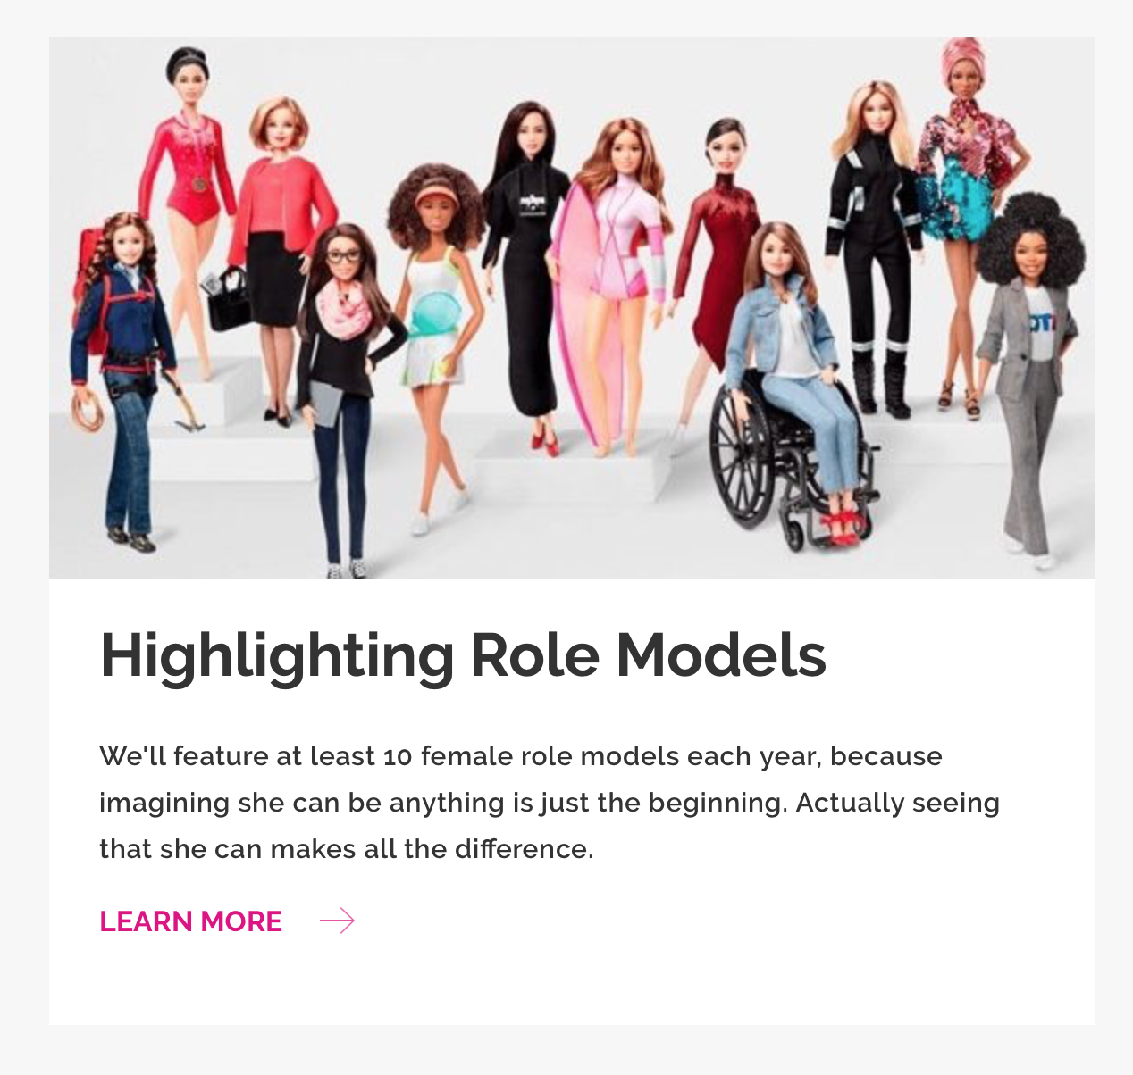
Who we see in a role matters
Exemplars shape stereotypes
Women in leadership
Dasgupta & Asgari, 2004
Mattel, 2019
Notes:
Followed female students in women-only. And in co-ed colleges
Did not differ at first; not self-selction
One year later, women immersed in env where they saw female faculty had less implicit gender stereotypes
Women in coed colleges had STRONGER implicit stereotypes

Slide 14
Influences on role selection
Alignment between self & role → entry into role
Goal congruity theory (Diekman et al., 2017, in press)
Situated authenticity as fit to environment model (Schmader & Sedikides, 2017)

Slide 15
II. Interpersonal interactions
Other-related cognitions
stereotypes, attitudes
Implicit & explicit knowledge about what is expected and appropriate for others
Interactions shape cognitions
Activation and justification
interactions
Gendered cognitions shape social perception & interactions
Thin-slice perception; self-fulfilling prophecy
Notes:
Gender cued immediately and nonconsciously
One of the first things encoded in interaction
Even inanimate entities are gendered (robots, numbers)
Beliefs aren’t just activated but they justify our actions – greater confidence or validity
Bottom arrow: SFP

Slide 16
Cues to gender in situation
Existing gender beliefs
Existing gender beliefs
Deaux & Major (1987) gender in interaction model

Slide 17
Examples of expectancies → behavior
Self-fulfilling prophecies: Who should be responsible for what?
Division of labor influenced by perceived gender of partner rather than actual gender of partner
Skrypnek & Snyder (1977); Hollingshead & Fraiden (2005)

Slide 18
I. Individuals
Self-related cognitions
self-concept,
gender identity
Implicit & explicit knowledge about what is expected and appropriate for the self
Individual processes/experiences shape cognitions
Gender categorization; balanced identity theory
individual
Gendered cognitions shape individual experience
Integration into the self

Slide 19
Balanced Identity Theory
self
“I’m a girl”
“I’m not good at math”
+
-
female
math
-
“Girls aren’t good at math”
Cvencek et al., 2020; Cvencek et al., 2011

Slide 20
Considering a problem from an embedded perspective: Gender disparities in STEM engagement

Slide 21
The problem
Degree attainment at highest level in field; Digest of Education Statistics, 2016

Slide 22
institutions
interactions
individual
Who is in STEM?
What goals does STEM afford?
How do specific contexts shape experience?
How are goals shaped by gender?

Slide 23
institutions
Societal institutions shape cognitions
Social role theory; role models
individual
Social role occupancy shapes gender & individual differences in goal endorsement

Slide 24
institutions
individual
Gendered cognitions shape institutions
Self-selection; justification
Gendered goal endorsement, paired with beliefs about roles, influences how individuals navigate the social structure

Slide 25
Gender differences & similarities in goals
Across 3 studies: communal goals d = -.51; agentic goals d = .10
Diekman et al., 2010; 2011

Slide 26
Beliefs about the role: STEM careers believed to impede communal goals
How much will each career fulfill
intimacy, affiliation, and altruism
power, achievement, and seeking new experiences or excitement
Robust across sex and major
Replicated with different samples, different careers, implicit measures
Simple effect for communal goals, η²_{G}=.53;
agentic goals, η²_{G}=.14
Diekman et al. (2010) Psyc Sci; (2011) JPSP
Notes:
Replicated within biobehavioral sciences too
Robust across sex and major
Replicated with implicit measures (not surprising because of big explicit effect)

Slide 27
Individual differences in communal goal endorsement
Diekman et al. (2010) Psyc Sci
Communal goals predict when controlling with self-efficacy, experience
Notes:
Communal endorsement mediates gender gap in STEM interest
Communal goal endorsement predicts discrepancy between fdom/STEM and mdom/STEM
Higher in communal goals, more discrepancy
Agentic goal endorsement also predicts discrepancy

Slide 28
Interactions & specific contexts
Experiences that highlight communal aspects of science can close gender disparities in STEM interest
Diekman et al., 2011; Steinberg & Diekman, 2018
Belonging – sense of fit

Slide 29
Communality in context: Field study at Women & Science Day
Middle school girls
Attended two keynote addresses & three sessions with hands-on activities
Not just exposure
No general effect on STEM positivity
No general effect on communal affordances
Can we predict who walks out with greater STEM interest?

Slide 30
End-of-day STEM communal affordances
End-of-day STEM belonging
.49 (.29)*
.24 (.27)***
.23 (.35)***
Session communal affordances
Unmediated: .16 (.16) †
End-of-day STEM career interest
*controlling for initial STEM communal affordances

Slide 31
End-of-day STEM communal affordances
End-of-day STEM belonging
.49 (.29)*
.24 (.27)***
.23 (.35)***
Session communal affordances
Unmediated: .16 (.16) †
End-of-day STEM career interest
Mediated: .04 (.04)
*controlling for initial STEM communal affordances

Slide 32
Implications
By taking into account individual level goals as they intersect with interactions and institutions, we understand patterns of institutional participation
Key to understanding gender disparities in other domains too: political leadership, business contexts
Framing political office as serving community reduces gender gap in “political ambition” (Schneider et al., 2016)
By understanding institutional culture, we know how to intervene to shift individual action

Slide 33
What now?

Slide 34
Understanding gender as embedded processes can provide resolution to paradoxes of gender
Gender has real impact even if it not biologically essential
Gender categories act as organizing forces, lead to expectations, and structure experiences
Gender cognitions are the fuel that form these categories & their consequences

Slide 35
To move toward equality
Reflect & assess:
Where is gender inequality apparent? What does equality mean in this context?
What institutional, interactional, and individual-level cognitions are relevant?
Identify obstacles:
What policies and practices reinforce or impose gender cognitions and experience?
Identify opportunities:
What policies and practices can disrupt these categorizations?
What does success look like?
Be prepared for resistance when you make gender trouble
Morgenroth & Ryan (2020)

Slide 36
Engineering & Computing Service Scholars Miami University
institutions
interactions
individual
Define merit as service experience and vision
Provide monetary & structural support
Living learning community
Intro class service learning
Communally-oriented

Slide 37
What is it to be embedded?
Images by unknown author, licensed under CC BY-SA

Slide 38
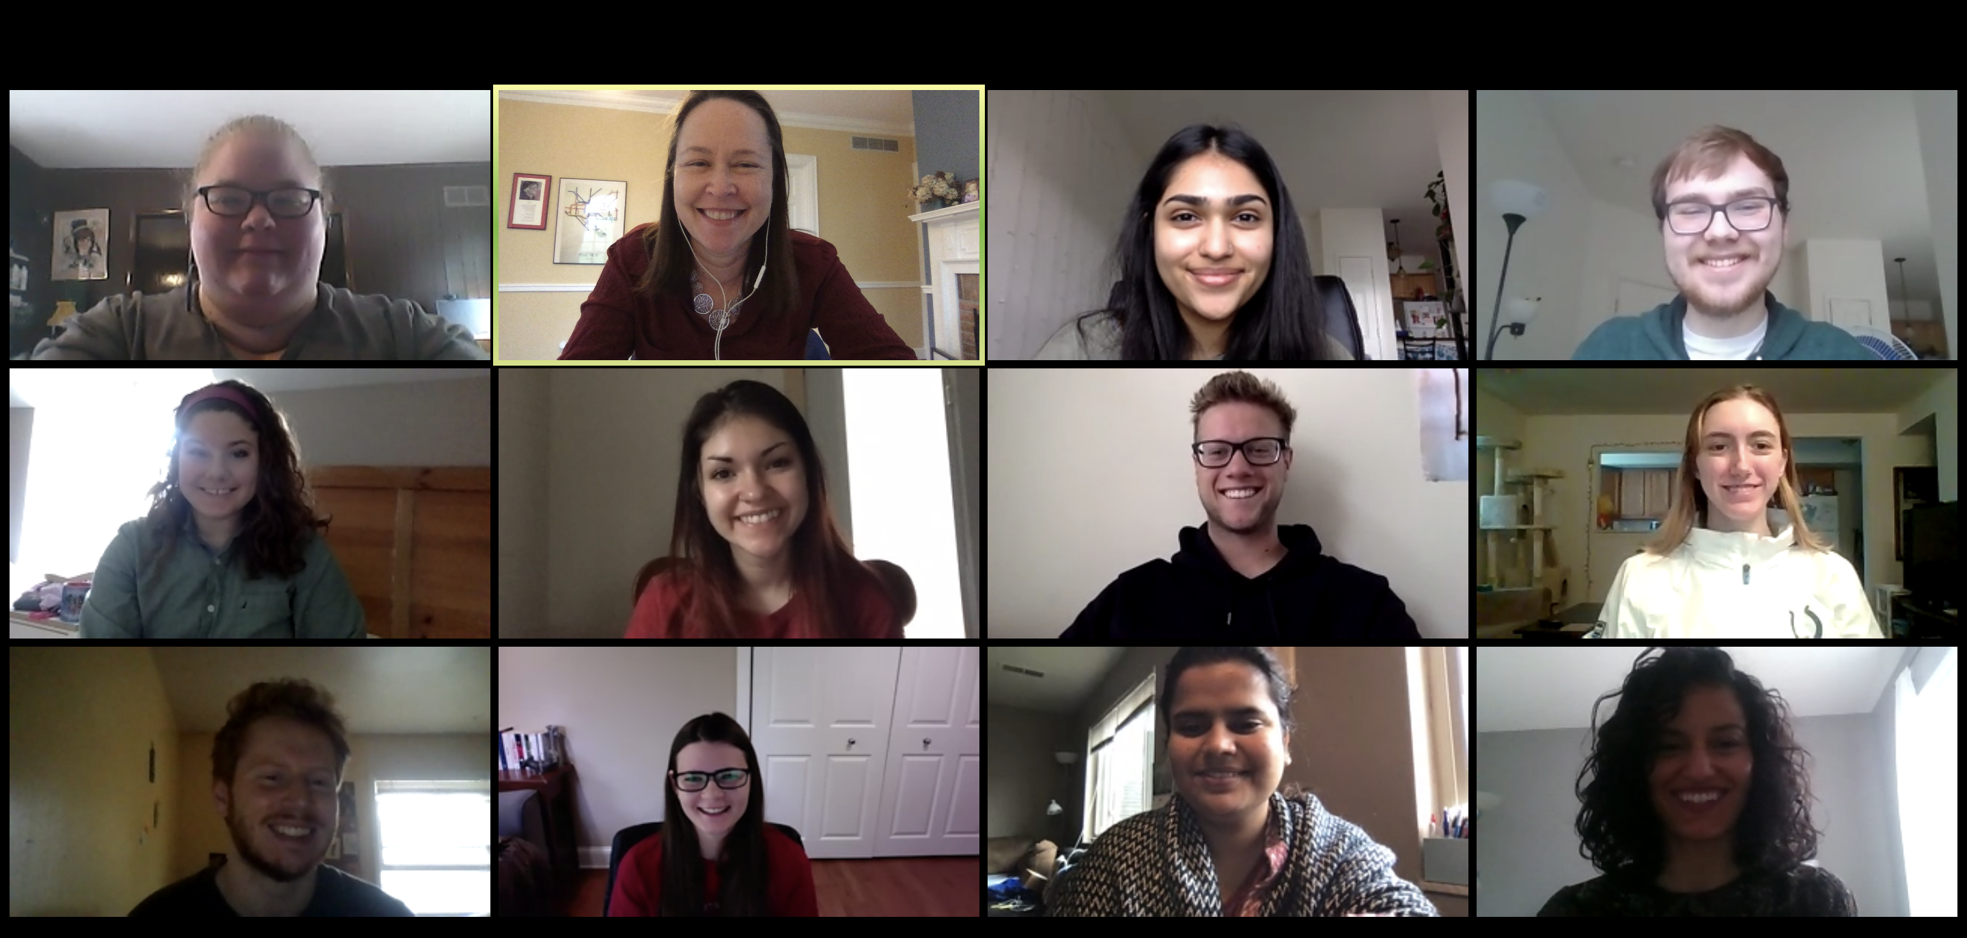
Thanks to….
Aimee Belanger
Tessa Benson-Greenwald
Bo Brinkman
Elizabeth Brown
Emily Clark
Heather Claypool
Melissa Fuesting
Mansi Joshi
Mary Murphy
Mia Steinberg
Erica Weisgram
Andrew White
National Science Foundation
Gender in Science and Engineering
NSF-GSE/RES 0827606
NSF-GSE/RES 1232364
NSF S-STEM 1355513
Sharon Luu
Alyssa Purvis
Melissa Rosensteel
Julie Carter
Yun Lu
Brian Wilkey
Jason Ream
Megan Considine
Shannon Rosenberg
JaNae Edwards
Scarlett O’Hara
Grace Hamelberg
Elizabeth Ryerson
Emily Wolf
Kristin Wiechart
Lauren Morgan
Steve Bower
Jarrod Kelly
Nicki Gardner
Nichole Edwards
Amber Brown
Sam Farina
Chrissy Graham
Caroline McClellan
Brianne Safer
Marie Yamada-Killilea
Maggie Winstel
Annie Bryan
Hayden Cook
Grace Campe
Tejumola Ogungbadero
Ruby Smith

